Slide 1
PROJECT REPORT
NOVEMBER 2023-2024
GALEFORCE
Where the Future Sets Sail
PRPARED FOR:
WRO INTERNATIONALS
BY:
JHANVARSHAN . N
SARANSH SINGHANIA
COACH: ABIRAMI RAJAGOPALAN

Slide 2
PROJECT REPORT
//
NOVEMBER 2023
O 2
TABLE OF CONTENTS
Team Introduction
Roles Summary of our project
Our Solution
Improvement
Social Impact
Present Prototype
One-Step Towards Reality
Conclusion

Slide 3
O 3 Team Introduction
and Roles
PROJECT REPORT //
NOVEMBER 2023
Abirami Rajagopalan
Role: Coach
I'm thrilled to stand as the coach of Team GaleForce from SRM Public School in this prestigious competition! Fueled by passion, I'm here to inspire and cultivate innovation in our students. We're not just constructing robots; we're forging a future of limitless potential and boundless excitement! Together, we're charging headfirst into this competition, ready to leave an indelible mark on the world of robotics!
Jhanavarshan.N
Role: Researcher, Designer
Super excited for this awesome chance! I've got tons of creative ideas and I'm all about grabbing every opportunity. Each moment is like a little universe of possibilities, and I'm here to bring in the fun of innovation. This journey is going to be seriously epic, and I'm all amped up to add a burst of lively energy!
Saransh Singhania
Role: Leader, Project Director
As the Leader and Project Director, my fervor for this competition runs deep. I've poured my heart and soul into steering this project towards triumph, leaving no room for complacency. The idea of victory serves as a beacon, illuminating my path and intensifying my dedication to achieving excellence. With unwavering resolve, I am poised to guide my team towards the pinnacle of success.

Slide 4
PROJECT REPORT
//
NOVEMBER 2023
Summary of our Project
In a world where the echoes of climate change and environmental decline are felt far and wide, the imperative for sustainable solutions reverberates across every industry. Amidst them, maritime transportation, deeply rooted in the age-old reliance on fossil fuels, faces a defining moment, much like a dinosaur clinging to its past. As concerns mount over greenhouse gas emissions and the dwindling reserves of conventional resources, a new path unfolds, akin to a prehistoric behemoth discovering wings, harnessing the timeless force of the wind to chart a course into the future. Here enters Galeforce, a trailblazer, armed with an arsenal of cutting-edge, adaptive fins, poised to tame this elemental force and navigate us towards an era of maritime enlightenment, much like a wise old dinosaur learning to soar the skies. In Galeforce's wake, we bid adieu to an epoch steeped in smog and set forth on a grand odyssey, powered by the very essence of nature. This is more than a journey; it is an anthem, a bold declaration that the future of maritime transport will be a realm where sustainability and exhilaration waltz hand in hand across the waves.
O 4

Slide 5
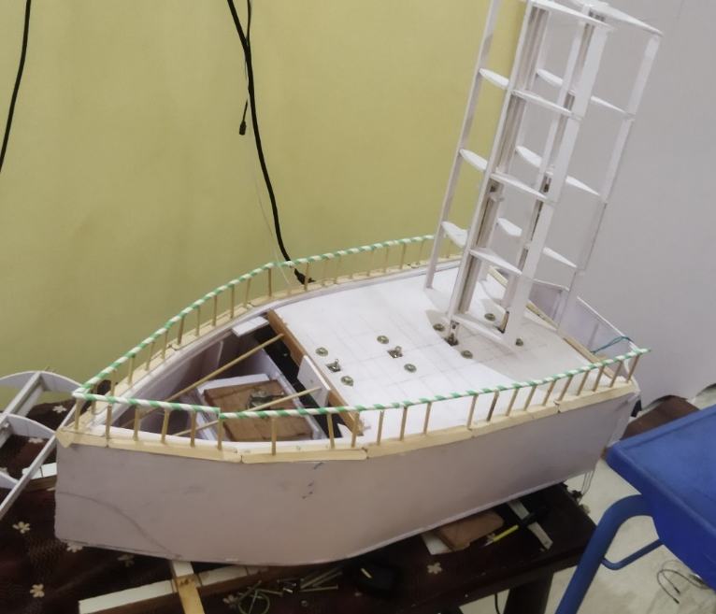
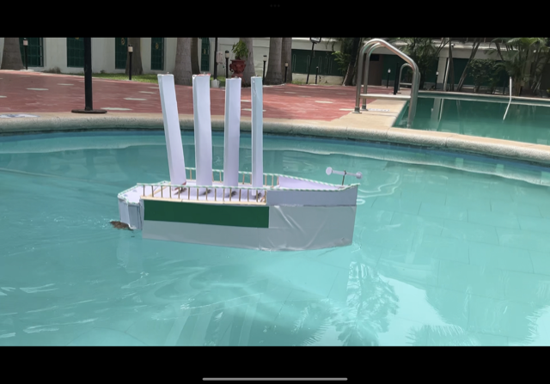
PROJECT REPORT
//
NOVEMBER 2023
O 5
Our Solution
Galeforce proudly boasts towering sails meticulously crafted from a blend of resilient alloys and cutting- edge composite materials, each standing an impressive 20 meters tall. Thanks to their exceptional telescopic design, these sails can stretch to a breathtaking 80 meters, tapping into the full potential of strong, steady winds at elevated altitudes.

Slide 6
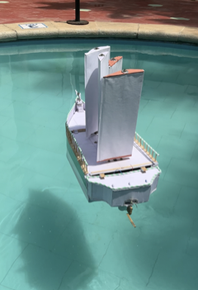
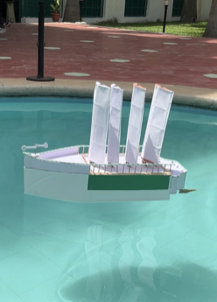
PROJECT REPORT
//
NOVEMBER 2023
0 6
Our Solution
Combined with the elevated deck's position above the waterline, the sails reach a staggering height of 105 meters. Utilizing sophisticated computational systems, the sails are intricately calibrated and finely adjusted, making the most of every breeze. Remarkably, all four sails possess the extraordinary ability to execute seamless 360-degree rotations independently, choreographing a graceful dance of movement.
Relying on crosswinds instead of tailwinds, Galeforce achieves an astounding 90% reduction in CO2 emissions, solidifying its position as a pioneer in forward-thinking, eco-conscious maritime innovation.

Slide 7
PROJECT REPORT
//
NOVEMBER 2023
O 7
Improvement
With unwavering dedication to maritime sustainability, we've embarked on a transformative journey, reshaping the Galeforce ship into a beacon of eco-friendly seafaring. Through the integration of state-of-the-art technology, featuring rotatable and retractable fins, we've unlocked a level of agility and efficiency that once seemed beyond reach. These fins, responsive to shifting winds, dynamically optimize the ship's performance. Furthermore, the incorporation of Nitinol anchors elevates stability and resilience, guaranteeing a secure voyage for crew and cargo alike. This groundbreaking fusion of cutting-edge engineering and environmental stewardship not only propels Galeforce towards a greener horizon but also establishes a paradigm for the future of sustainable shipping worldwide.

Slide 8
PROJECT REPORT
//
Social Impact
NOVEMBER 2023
O 8
As our vessel emerges as a prototype, its potential for transformative impact transcends the maritime sector's boundaries. We steadfastly believe that pioneering an environmental solution for one industry sets a formidable precedent, sparking a cascade of change across diverse sectors. Even in its early stages, our prototype stands as a beacon of inspiration, sparking the imaginations of innovators worldwide.
In this way, every individual's creative ingenuity, regardless of scale, plays a pivotal role in our collective pursuit of a lush, cerulean, and brilliantly illuminated future.
The reverberating influence of our vessel echoes through the realms of innovation, catalyzing a surge of environmental awareness that vows to shape a world of limitless potential.

Slide 9
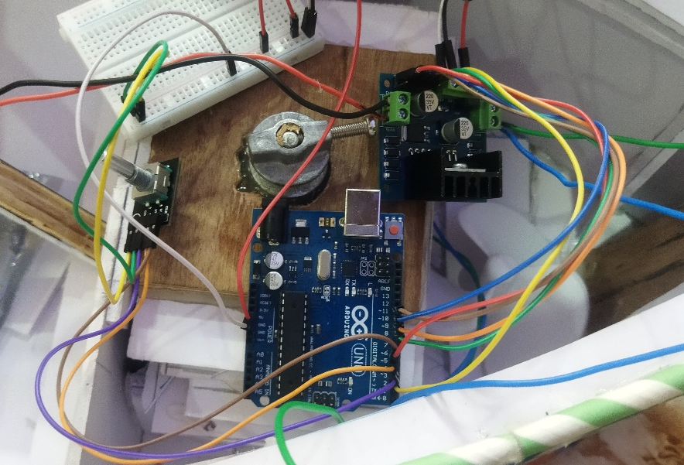

PROJECT REPORT
//
NOVEMBER 2023
O 9
Our Present Prototype
In our cutting-edge prototype, we place a laser-sharp focus on Galeforce's defining feature: the self-regulating fins, finely attuned to data relayed by the anemometer. At the epicenter of this innovation lies Arduino, an open- source electronics platform revered for its unrivaled adaptability. Through Arduino, we orchestrate the system's intricate programming, precisely dictating functionalities via input data, analog pins, and a comprehensive range of modules.
Galeforce: Where the wind becomes our ally, and innovation charts a course towards a sustainable tomorrow.

Slide 10
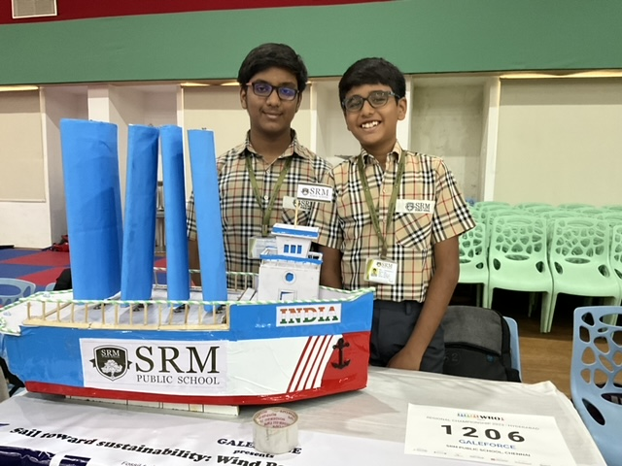
PROJECT REPORT
//
NOVEMBER 2023
O 9
Our Present Prototype
This boundless versatility, coupled with its seamless compatibility, renders Arduino an irreplaceable choice. As we navigate through the myriad options at our disposal, we harness Arduino's sleeker design, amplified fin size, exhaustive research, and a design approach that reaches for the pinnacle of optimization. This amalgamation empowers us to craft a prototype that encapsulates the zenith of attributes from diverse avenues, setting the stage for an era of maritime innovation that stands unmatched in its prowess and potential.
Galeforce: Where the wind becomes our ally, and innovation charts a course towards a sustainable tomorrow.

Slide 11
PROJECT REPORT
//
NOVEMBER 2023
1 0
One-Step Towards Reality
While our prototype may not encompass the full-scale vision of Galeforce, it undeniably marks a significant stride toward its realization. In the initial stages, the prospect of crafting a prototype from our ambitious concept seemed a formidable challenge.
Thus, we opted for a focused approach, honing in on a singular facet of the concept, and allowing it to serve as the cornerstone of our prototype.
This deliberate methodology culminated in the creation of our present iteration.
Although it may not embody the complete spectrum of the original concept's capabilities, it represents an inaugural stride toward the transformation of our imaginative vision into concrete reality.

Slide 12
PROJECT REPORT
//
NOVEMBER 2023
1 1
Conclusion
In retrospect, the journey of creating our prototype was an invigorating yet demanding adventure. While complexities were evident, our resolute team pushed forward, culminating in the birth of Galeforce's inaugural model. The odyssey has been truly transformative, and we hold a profound appreciation for the ground we've covered in both the competition and our project. Through this prototype, we've unearthed a trove of innovative possibilities, delving into diverse applications of components and beyond. Though it carries imperfections, we don't see this prototype as a finality, but rather as a pioneering force poised to shape the future of our planet—an emblem of a Zero Emission Earth, where the boundless tapestry of life, both aquatic and terrestrial, thrives in harmonious synchrony. We present it with immense pride, knowing it signifies a monumental step towards a sustainable and flourishing global ecosystem.

